Slide 1
MongoDB

Slide 2
MongoDB - Terminologies
Relational | MongoDB
Database | Database
Table | Collection
Row | Document

Slide 3
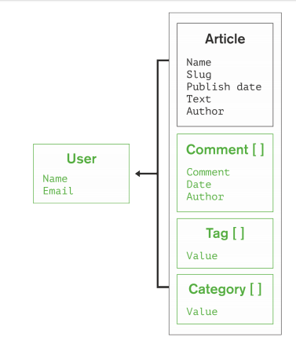
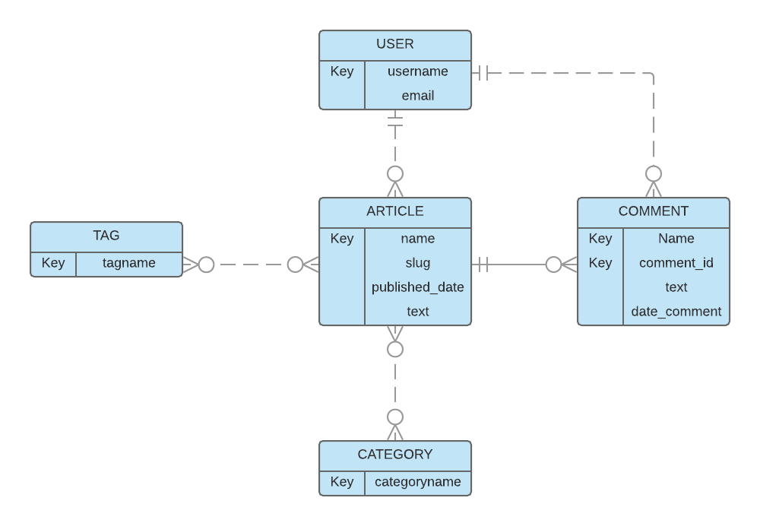
Document vs Relational
Document DB
2 collections
No Join
Embed USER in POST
OR
Refer USER in POST
Relational DB
7 tables
Many joins

Slide 4
BSON – Binary JSON
MongoDB document objects.
It provides more data types, eg date, integer, float

Slide 5

MongoDB Architecture
Mongo drivers
Eg. PyMongo
BSON
Applications
BSON
MongoShell
Mongo server
Mongo connectors
Eg. Mongo_Spark
Platforms

Slide 6




Using MongoDB shell
Run the MongoDB server (you don’t need to do this in the VM)
mongod
Run the Mongo shell
mongo
https://docs.mongodb.com/manual/reference/mongo-shell/

Slide 7
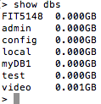

Using Mongo Shell
List existing databases
List existing collections

Slide 8
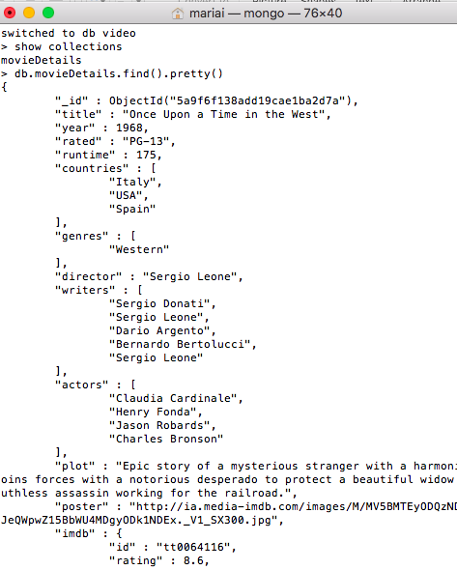
Using Mongoshell
List the contents of a collection.

Slide 9
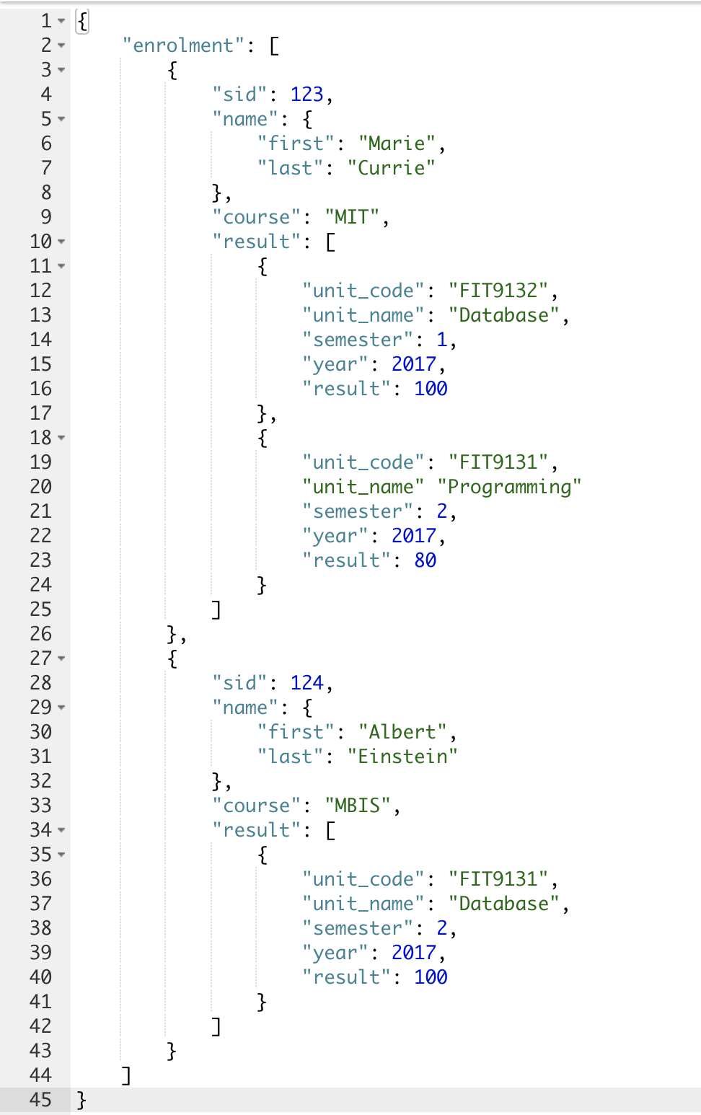
Case study – University database
Enrolment
collection
STUDENT
STUDENT
STUDENT
COURSE
COURSE
COURSE
RESULT
RESULT
RESULT
UNIT
UNIT
UNIT
GRADE
GRADE
GRADE

Slide 10
CRUD operations in MongoDB
MongoDB | SQL
CREATE (database, collection), INSERT | DDL and INSERT
FIND() | SELECT statement
UPDATE | UPDATE
DELETE | DELETE

Slide 11
CREATE
Create a database
USE database
Create a collection
db.createCollection(“FIT”).
Schema definition is optional!

Slide 12
Inserting Document (ONE)
db.collection.InsertOne()
db.FIT.insertOne (
{ “_id”:121,
…
}
)

Slide 13
Inserting Document (MANY)
db.collection.insertMany()
db.FIT.insertMany (
[
{ “_id”:123, …},
{“_id” :124,…}
],
{ “ordered”: false}
)
Inserted as a collection of array elements. Each of the element is a document.

Slide 14
READ
Use the collection methods
db.collection.find()
The argument for the function is a JSON document.
The return will be a single or many JSON documents.
Examples.
db.FIT.find({“name.last”:”Lovelace”})
db.FIT.find({“result.unit_code”:”FIT9132”})

Slide 15
Querying
Read operation
https://docs.mongodb.com/manual/crud/#read-operations
Query operators
https://docs.mongodb.com/manual/reference/operator/query/

Slide 16
UPDATE
db.collection.updateOne(<filter>, <update>, <options>)
db.collection.updateMany(<filter>, <update>, <options>)
db.collection.replaceOne(<filter>, <replacement>, <options>)
Example:
db.FIT.updateOne({"_id":121},{$set: {"course":"MDS"}})
db.FIT.updateMany({"course":"MBIS"},{$set: {"course":"MDS"}})

Slide 17
UPDATE ONE
SQL
UPDATE student
SET course=‘MDS’
WHERE student_id = 123;
MONGO
db.FIT.updateOne(
{"_id":121},
{$set: {"course":"MDS"}}
)
FOUND
NOT FOUND

Slide 18
UPDATE MANY
SQL
UPDATE student
SET course=‘MDS’
WHERE course=‘MBIS’;
MONGO
db.FIT.updateMany(
{"course":"MBIS"},
{$set: {"course":"MDS"}}
)

Slide 19
DELETE
db.collection.deleteMany()
db.collection.deleteOne()
db.collection.drop()
Examples:
db.FIT.deleteOne({"_id":121})
db.FIT.deleteMany({"course":"MDS"})
db.FIT.drop()

